Slide 1
A Gentle Introduction to Facial Recognition System Using OpenCV
Presented by: Abimbola Olawale
@PyconNG 2019

Slide 2




About Me
I’m Human and Nigerian
Name is Abimbola Olawale Victor
Graduate of Statistics
Data Analyst
AI enthusiast
Emerging machine learning expert
Love Researching
@bimbolawale
github.com/olawale0254
abimbolaolawale41@gmail.com

Slide 3
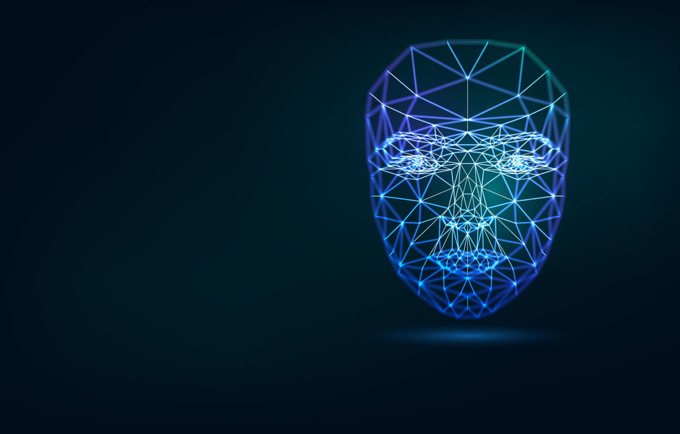
Overview
Introduction
Facial Detection
Facial Identification
OpenCV
Demo

Slide 4
Introduction
For more than a decade or so, facial recognition has become a popular area of research in computer vision and one of the most successful applications of image analysis and understanding. Because of the nature of the problem, not only computer science researchers are interested in it, but neuroscientists and psychologists also.

Slide 5
Face Detection
What is Face Detection?
Face detection is an AI-based computer technology that can identify and locate the presence of human faces in digital photos and videos.
Face detection algorithm works in such a way that it use algorithms that determine whether images are positive images (i.e. images with a face).

Slide 6
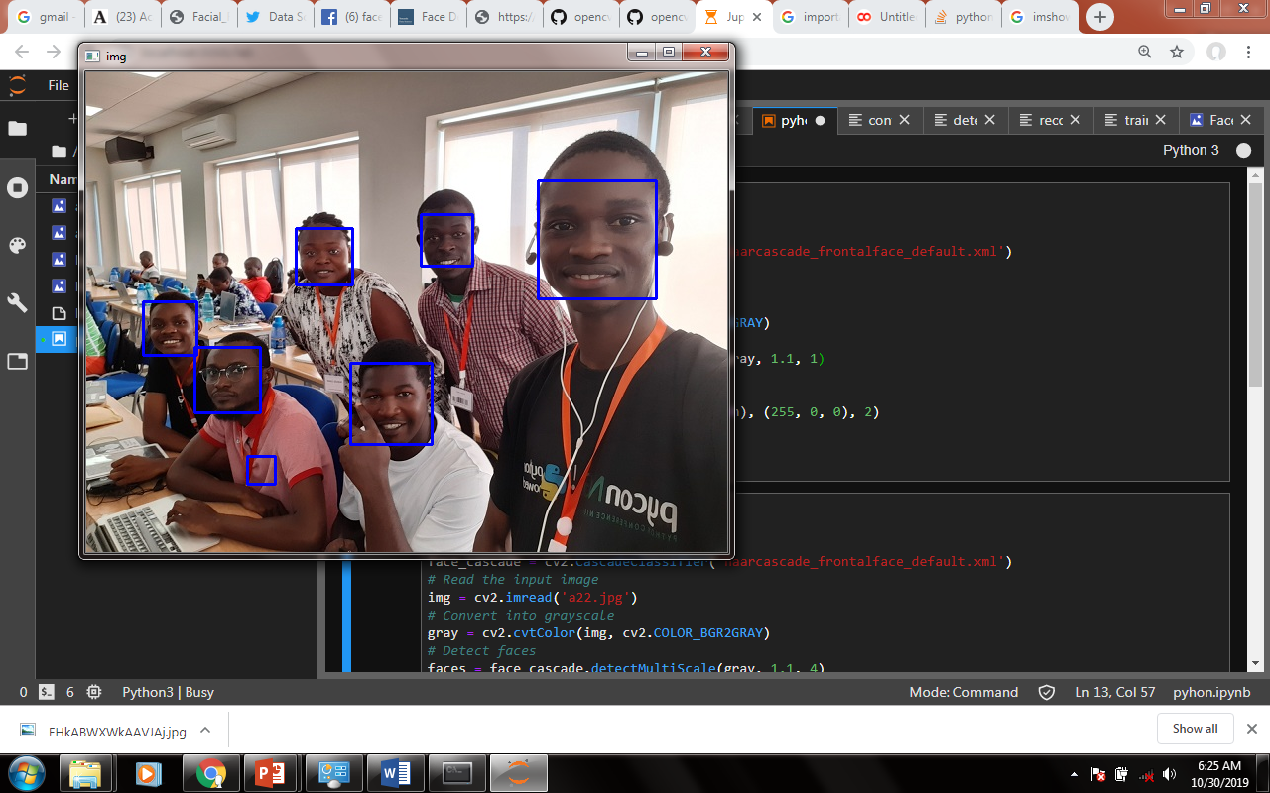
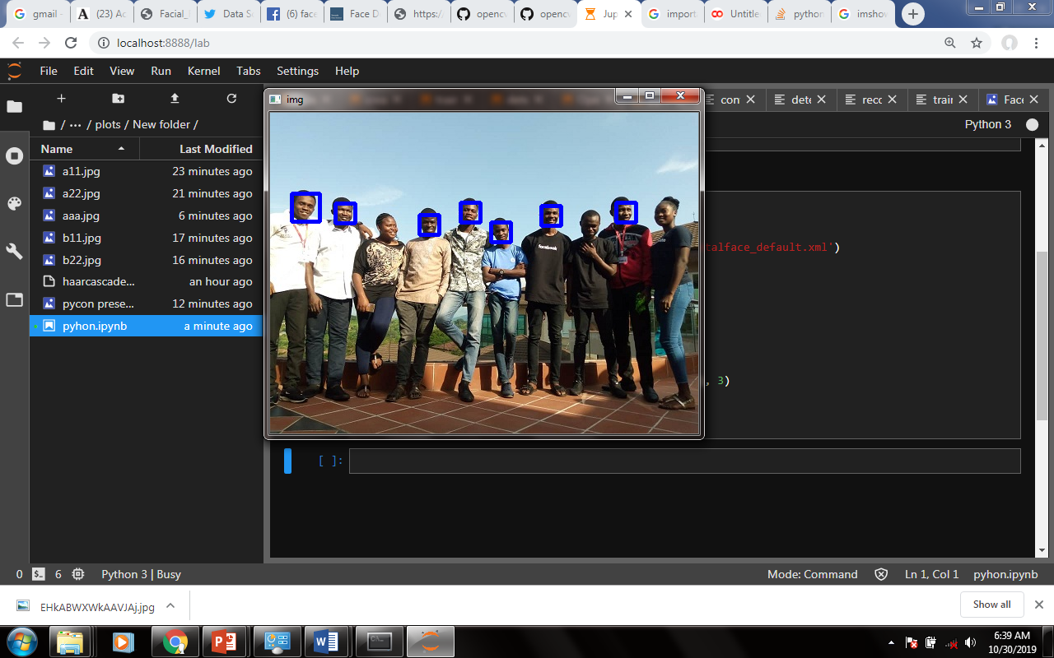
Face Detection(cont)

Slide 7
Face Recognition
Facial recognition is a biometric software application capable of uniquely identifying or verifying a person by comparing and analyzing patterns based on the person's face. Facial recognition is mostly used for security purposes, though there is increasing interest in other areas of use. In fact, facial recognition technology has received significant attention as it has potential for a wide range of application related to law enforcement as well as other enterprises.

Slide 8
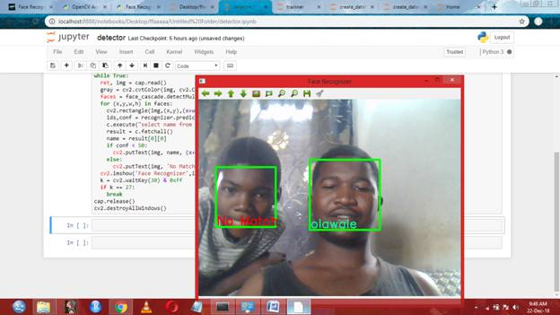
Face Recognition

Slide 9
OpenCV
OpenCV is one of the best and effective computer vision open source library.
It is free
You can build your Facial Recognition/Detection with few lines of codes

Slide 10
OpenCV Face Recognizers
OpenCV has three built in face recognizers and thanks to OpenCV's clean coding, you can use any of them by just changing a single line of code.
Below are the names of those face recognizers and their OpenCV calls.

Slide 11
OpenCV Face Recognizers
EigenFaces Face Recognizer Recognizer -`cv2.face.createEigenFaceRecognizer()`
FisherFaces Face Recognizer Recognizer - `cv2.face.createFisherFaceRecognizer()`
Local Binary Patterns Histograms (LBPH) Face Recognizer-`cv2.face.createLBPHFaceRecognizer()

Slide 12
EigenFaces Face Recognizer
This algorithm considers the fact that not all parts of a face are equally important and equally useful. When you look at some one you recognize him/her by his distinct features like eyes, nose, cheeks, forehead and how they vary with respect to each other. So you are actually focusing on the areas of maximum change (mathematically speaking, this change is variance) of the face. For example, from eyes to nose there is a significant change and same is the case from nose to mouth. When you look at multiple faces you compare them by looking at these parts of the faces because these parts are the most useful and important components of a face.

Slide 13
EigenFaces Face Recognizer(cont)
EigenFaces face recognizer looks at all the training images of all the persons as a whole and try to extract the components which are important and useful (the components that catch the maximum variance/change) and discards the rest of the components. This way it not only extracts the important components from the training data but also saves memory by discarding the less important components. These important components it extracts are called principal components.

Slide 14
FisherFaces Face Recognizer
This algorithm is an improved version of EigenFaces face recognizer. Eigenfaces face recognizer looks at all the training faces of all the persons at once and finds principal components from all of them combined. By capturing principal components from all of faces combined you are not focusing on the features that discriminate one person from the other but the features that represent all the faces of all the persons in the training data as a whole.

Slide 15
Local Binary Patterns Histograms (LBPH) Face Recognizer
We know that Eigenfaces and Fisherfaces are both affected by light and in real life we can't guarantee perfect light conditions. LBPH face recognizer is an improvement to overcome this drawback.
Idea is to not look at the image as a whole instead find the local features of an image. LBPH alogrithm try to find the local structure of an image and it does that by comparing each pixel with its neighboring pixels.

Slide 16
c
Cascade Classifier
The word “cascade” in the classifier name means that the resultant classifier consists of several simpler classifiers (stages) that are applied subsequently to a region of interest until at some stage the candidate is rejected or all the stages are passed.

Slide 17
BUILDING A FACIAL RECOGNITION SYSTEM
Prepare the Database (sql-lite)
Prepare your Dataset
Train your Recognizer
Detect

Slide 18
BUILDING A FACIAL RECOGNITION SYSTEM
LIBRARIES
OpenCV
Sql-lite
Numpy

Slide 19


